Slide 1


Learning in the Early Years
Nursery
Ladybirds with:
Teachers: Mrs Galliford & Mrs Lewis. TA's: Mrs Burchill, Mrs Tunnah, Mrs Stephens & Mrs Puddy.

Slide 2
Day to Day Routine
The children will have a mixture of learning opportunities throughout the nursery day including whole group inputs, keyworker group times, teacher led, self sustained and child initiated activities. All children will access all areas of the nursery during free flow continuous provision.
As the children progress through the Nursery year the proportion of small group times will increase.

Slide 3


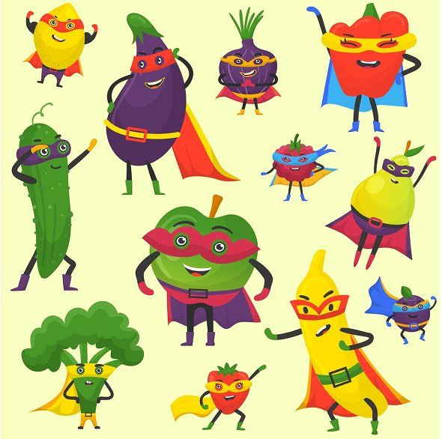
Enquiry’s
Term 1- Who Am I?
Term 2- Why is winter wonderful?
Term 3- What makes a good pet?
Term 4- What happens on the farm?
Term 5- Who helps me?
Term 6- What’s in the deep blue sea?

Slide 4


Areas of Learning
We will be using Development Matters for the Children’s learning. Here are the seven areas of development:
Personal, Social and Emotional Development
Communication and Language
Physical Development
Literacy
Mathematics
Understanding the World
Expressive Art and Design

Slide 5
Prime Areas
Daily story times using high quality picture books.
Sing a variety of rhymes and songs.
Provide opportunities for your child to have social interactions with their peers, e.g. playdates.
Ask your child questions about their Nursery day, e.g. using weekly Tapestry posts.
Recast what the children say through modelling, e.g. I swimmed – Yes you swam in the sea on holiday!
Strengthen and develop Gross Motor Skills through physical play, e.g. riding bikes, climbing equipment.
Encourage your child to use a knife and fork at meal times.
Encourage your child to wash their hands and the use the toilet independently.
Encourage your child to be involved with their own self care, e.g. getting dressed, preparing Nursery bag.

Slide 6


Math’s
Encourage your child to point out numbers in the environment.
Random counting to 5, e.g. counting steps, claps.
Sing counting nursery rhymes, e.g. Five Little Ducks.
Identify shapes and patterns in the environment. Can you find a circle in the garden?
Exploring puzzles.
Water play using jugs, cylinders, buckets etc.

Slide 7
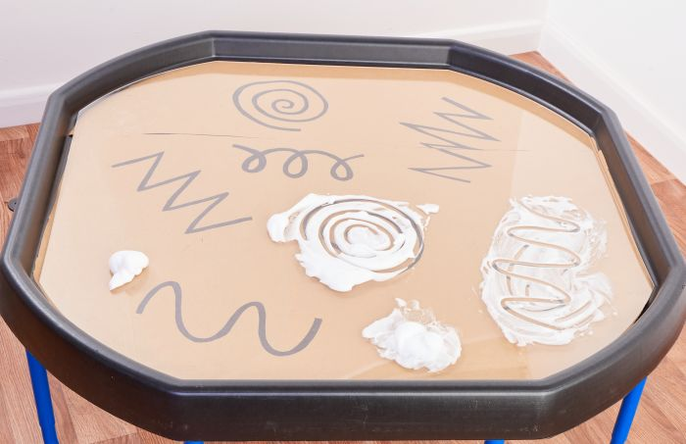
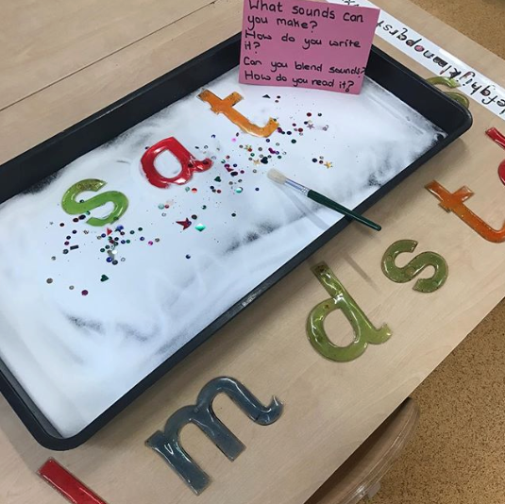
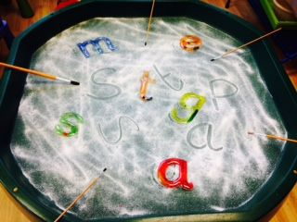
Reading & Writing
Read a variety of high quality picture books and explore the narrative together.
Encourage your child to recognise their name.
Develop fine motor skills through various activities, e.g. threading, using cutlery.
Use a variety of mark making resources, including, jumbo paintbrushes, large chalk.
Encourage your child to make various marks, e.g. zigzags, swirls, lines, circles.

Slide 8

Phonics
In Nursery we will cover Phase 1: sound discrimination, phonological awareness, rhyme, oral blending and segmenting. How will this happen?
A wealth of listening activities, e.g. Listening walks and sounds in the environment, recognising instrumental sounds, using body percussion.
Spotting rhythm and rhymes in songs and stories.
Oral segmenting and blending, e.g. What Am I? Using sound talk – c.a.t
Phase 1 forms the ‘bedrock’ of developing children’s early reading ready for Reception.

Slide 9
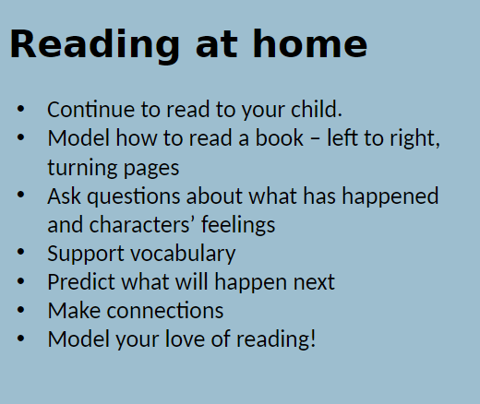

Slide 10

Recommendations

Slide 11

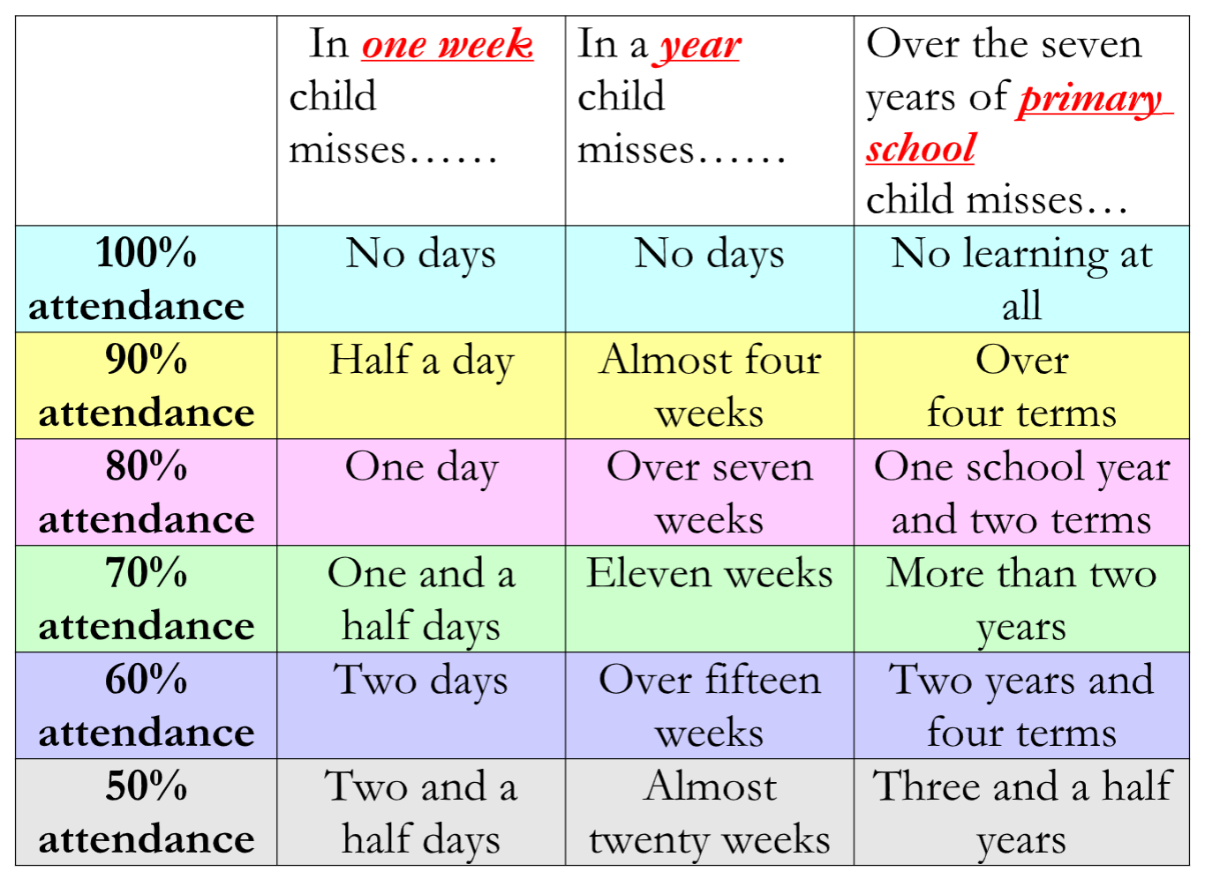
Attendance
It is very important that your child/ren come to school every day. However, if children are unwell, please ring the school office and leave a message with details of your child’s absence. Please call on each day of your child’s absence. If we are not given a reason for absence, your child/ren will receive an unauthorised absence mark.
Punctuality is also very important; if children arrive late, they may miss important information to support their learning and it can also cause upset, arriving after their peers.
If you do arrive late, you will need to go to the office and complete an online form. This is so we can monitor punctuality and support where necessary.
If you were to achieve 90% on a test, you would probably be very happy. However, if a child attends school only 90% of the time, they will have missed 4 weeks by the end of the school year!

Slide 12
Holidays
In accordance with local authority guidance, holidays during term time will only be authorised in the most exceptional circumstances.
Unauthorised holidays/absences may incur a penalty notice fine from the local authority.

Slide 13
Personal Information
It is very important that we have phone numbers and addresses for all parent/carers and would kindly ask that you keep the school updated should any parent/carer have a change of details. Please also update any medical information as necessary.

Slide 14


Tapestry!
We encourage you to add home learning to be celebrated at Nursery!

Slide 15




Our Website
Please check our Nursery page on the website for updates and important dates.
Select the Children icon from the bar and click class pages.
Select your year group.

Slide 16
Lastly…
Please remember to bring one piece of fruit/vegetable for snack with a bottle of water. No other snacks please. Please ensure that packed lunches are healthy and try to avoid cooked foods please.
Please write your child’s name on all personal belongings and clothing. This is very important as the children often can not identify their own belongings.

Slide 17


Thank you!
We hope your child has the best year with us!

